Slide 1
DCD991 / DCD996 eClutch Diagnostic Flowchart [DOC100271506: Rev-0]
FUNCTIONAL CHECK:
To better diagnose our new eClutch and related sensors. We have assembled an initial diagnostic flowchart to better pinpoint the root cause of a potential customer complaint.
A customer may come in with a complaint that the drill is drilling in clutch mode or clutching out in drill (or hammer) mode. In either case the following flowchart should be followed to ensure that the drill is functioning correctly before disassembly.
Put Drill in Clutch #1, Speed 3 and pull the trigger, hold for 2 seconds.
Do you hear a slow ramp up in motor RPM?
Did the tool maintain a steady speed?
When Drill reaches steady speed, is it slower than the top speed for Drill Mode?
YES
YES
YES
NO
NO
C
NO
D
Put Drill in Clutch #2, Speed 3 and pull the trigger.
Drill is functioning correctly.
When Drill reaches steady speed, do you hear a higher RPM than the steady speed when in Clutch #1, but still slower than Drill Mode?
NO
YES
Drill is functioning correctly.
D
A

Slide 2
A
Put Drill in Clutch #11, Speed 3 and pull the trigger.
Do you hear the tool reach steady speed faster than when in clutch #2?
When Drill reaches top speed, do you hear a similar speed as Drill Mode?
D
NO
YES
YES
NO
D
Put Drill in DRILL MODE, Speed 3 and pull the trigger.
Drill is functioning correctly.
Is the motor response immediate (e.g. no ramp up) when you pull the trigger?
D
NO
YES
Drill is functioning correctly.
FIRMLY grab chuck wearing leather work gloves and pull trigger.
Put Drill back into Clutch #1, Speed 3.
B

Slide 3
B
Does Drill clutch out immediately?
D
NO
YES
Release hand from Chuck. Drill is functioning correctly.
C
C
Did the unit reach and sustain a top speed 8 out of the 10 times?
Put Drill in Clutch #1, Speed 3 and pull the trigger 10 times for 2 seconds each time.
(Do not hold the chuck.)
YES
Drill is functional.
(Return to top of diagnostics if not already completed)
NO
Did you already replace the transmission SA’s?
Replace Tool
YES
NO
Replace transmission SA’s #19, #20, and ring gear #16
C

Slide 4
D
ELECTRICAL CHECK:
Remove housing and gearcase screws, opening up and removing cover side handle. Carefully remove Transmission Front End and Module/Motor together as one full unit.
Inspect all wires for pinches, nicks, or cuts. Anything abnormal can effect function.
This next step is to interrogate the electrical inputs and outputs from Clutch Position Sensor (CPS)
While on ESD mat with grounding wrist strap; pull motor out of transmission.
Disconnect Clutch Position Sensor (CPS) from Switch Module. Make sure the pins were seated in the connector and not installed under it.
Clutch Setting | Ω ±1%
#1 | 2000
#2 | 4000
#3 | 5870
#4 | 7740
#5 | 9790
#6 | 12600
#7 | 16400
#8 | 21040
#9 | 27380
#10 | 37140
#11 | 50140
DRILL | 72240
HAMMER | 106240
Put Clutch Collar in Clutch Setting #1
With multi-meter, probe the 2 pins of the CPS connector.
Is the Ω value within the range given in the table?
NO
YES
Repeat for all Clutch Settings (#2 to #11), DRILL MODE and HAMMER MODE.
E

Slide 5
ELECTRO-MECHANICAL CHECK:
Further disassembly is not required.
E
Visually inspect Clutch Position Sensor (CPS) wires
Replace Module
(Item# 34)
Reassemble Front End
NO
Are all wires, and connector pins/bodies in good condition?
Are all wires, connections and connector pins/bodies from module intact?
YES
NO
YES
Replace Service SA Gear Case
(HD: Item#1-11)
(DD: Item#1, 6-11)

Slide 6
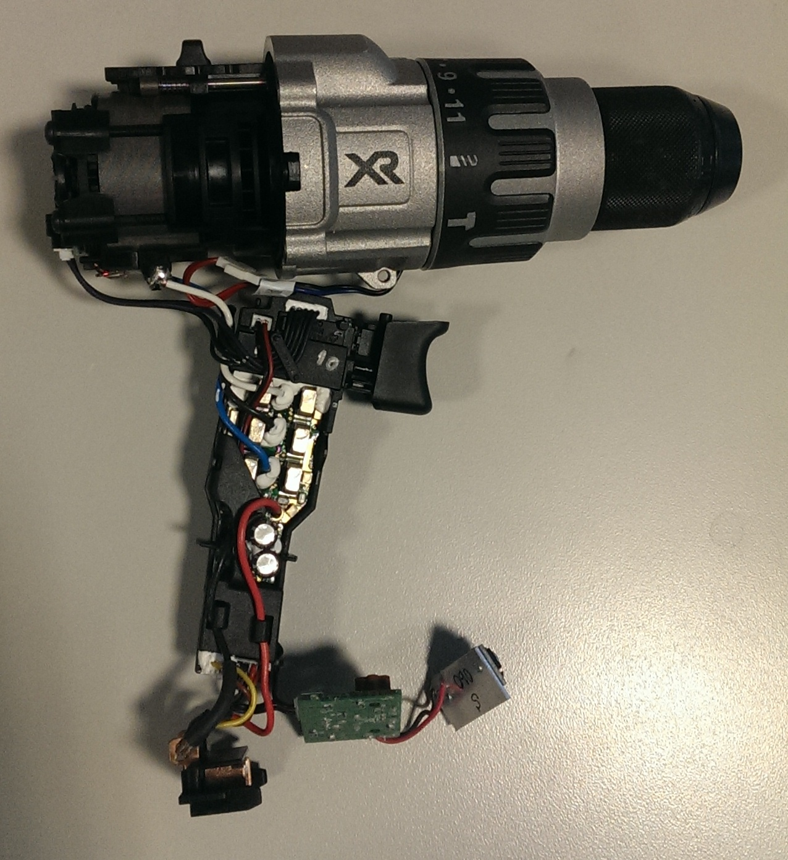
Image Appendix

Slide 7
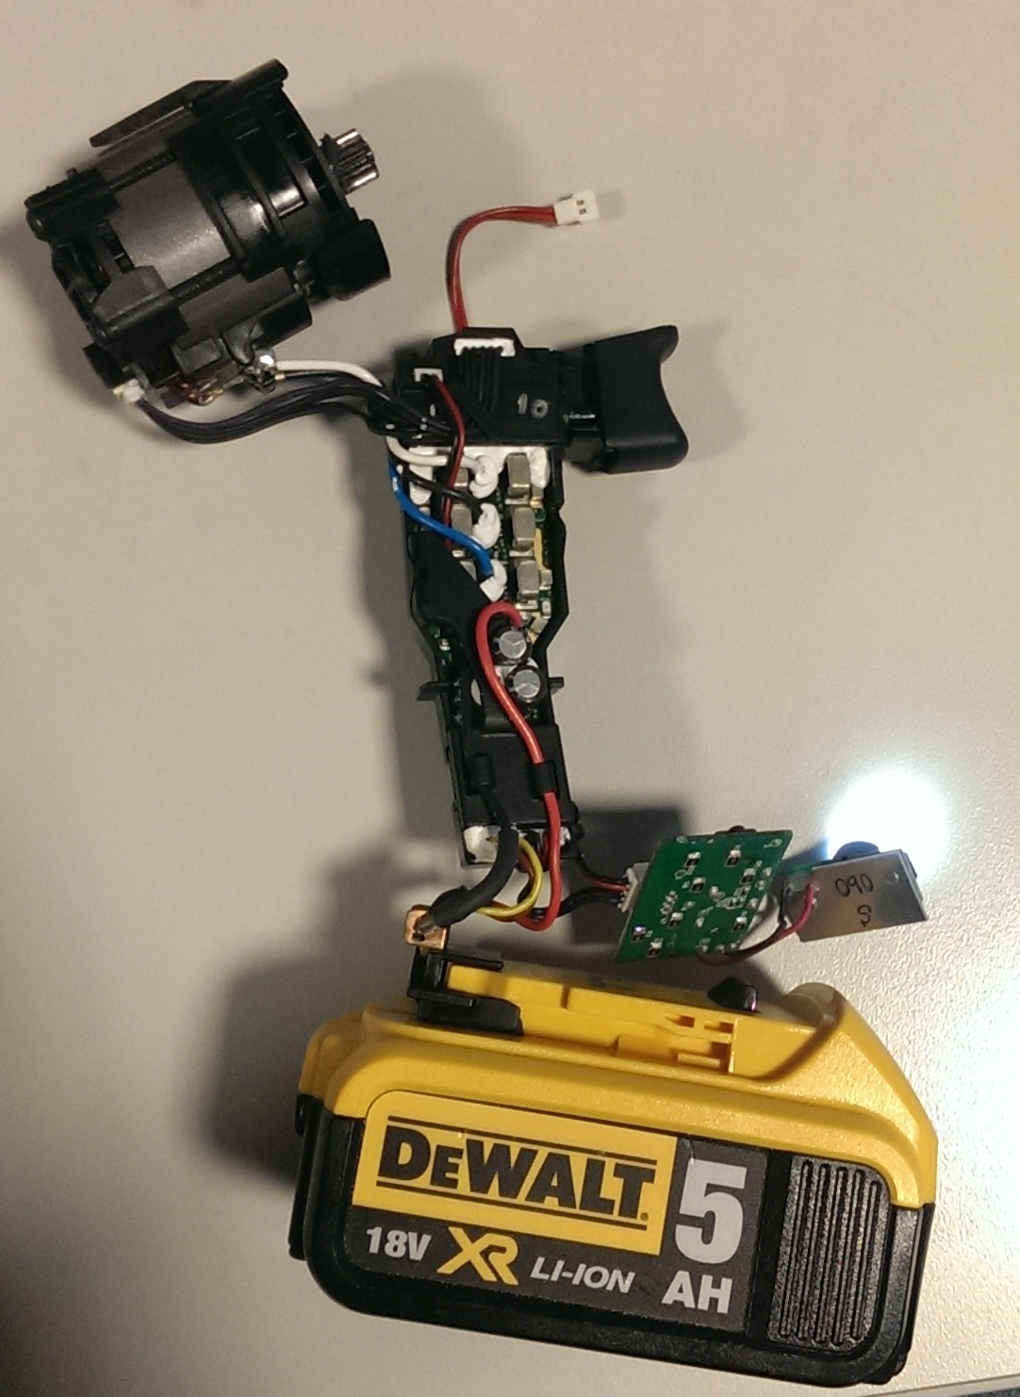
Power Wire (RED)
Ground Wire (BLK)
LED on indicates power to Sensor

Slide 8
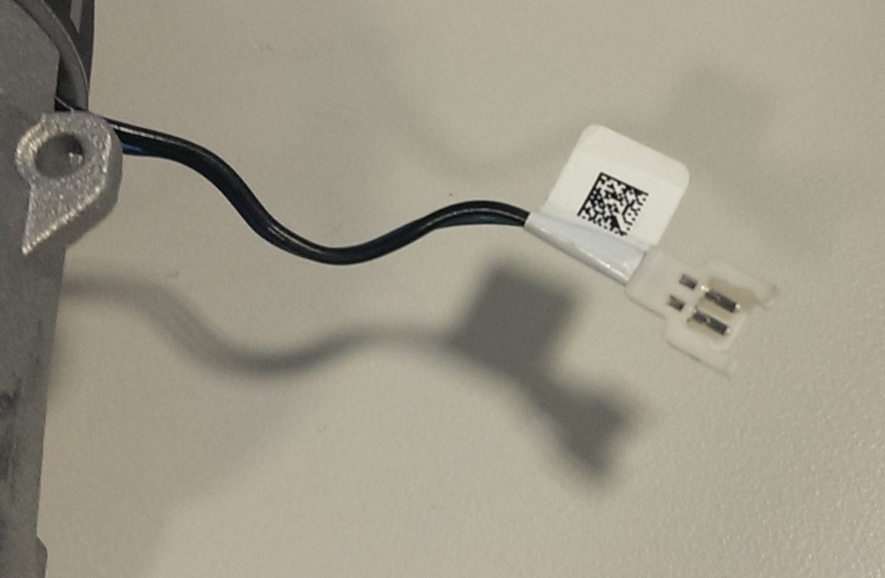
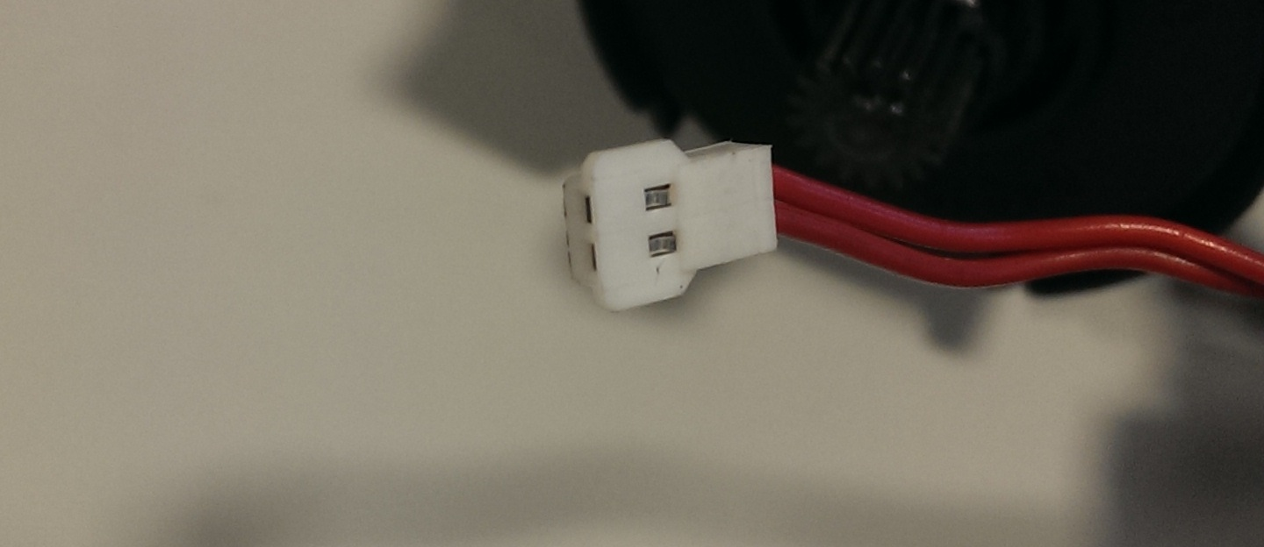
Occasionally the pins will get bent down and slide under the mating connector instead of into. Inspect units for this, and be sure not to do this.
Connector pins should be pushed fully into connector body.

Slide 9
