Slide 1
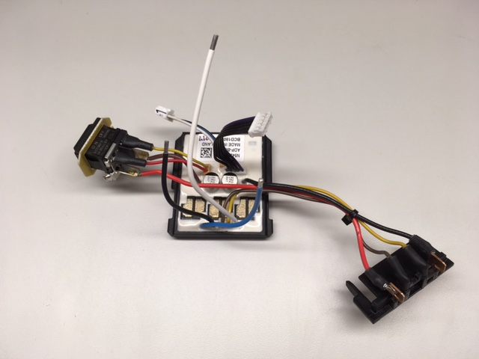
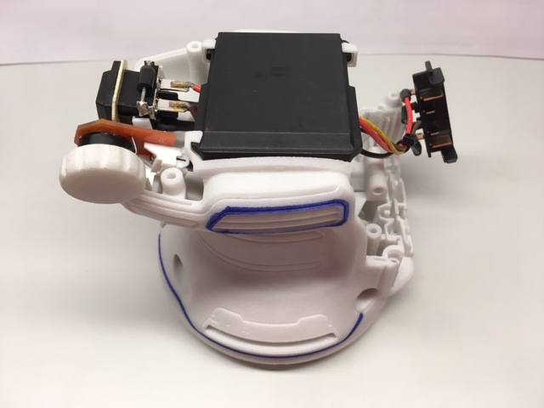
Random Orbit Sander
Module & Tool Wiring
LM6-C Module: N542902
Catalog Number: DCW210
CN0297066 DOC100380110
Version 0 26 July 2018

Slide 2
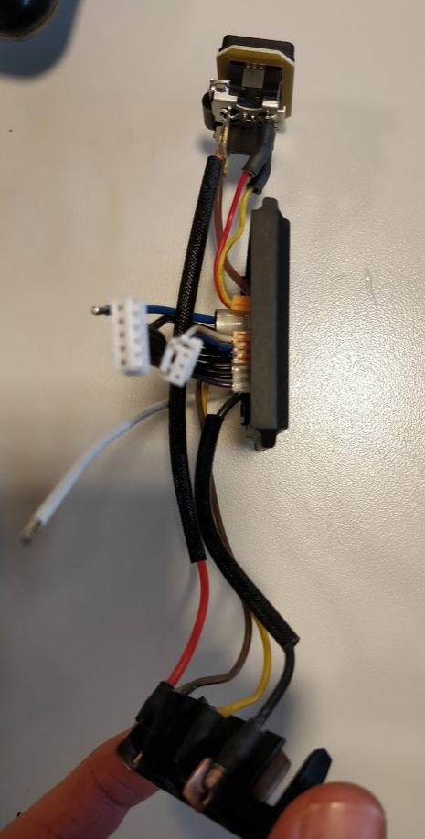
LM6-C Module Wiring
Delta Part Number: ADP-B064-C/CA
SBD Part Number: N542902
*module must have fiber-glass sleeves on B- wire and B+ wire, not shown throughout this presentation

Slide 3
1. Wire grouping and direction from module
U, V, W, & Hall wires
(UP)
Speed dial & switch (LEFT)
Terminal block (RIGHT)

Slide 4
2. Terminal block wire routing
B+ Red wire
Inside motor wires
Battery MGM wires
Inside motor wires
UVW wires
Outside of battery/switch wires

Slide 5
3. Switch & speed dial wire routing
Speed dial wires
Behind & under Hall wires
3x switch wires
Behind motor wires

Slide 6
4. Zip tie located according to assembly drawing

Slide 7
Tool Wiring &
Suggested Assembly
LM6-C Module: N542902
Working Unit: N542085

Slide 8
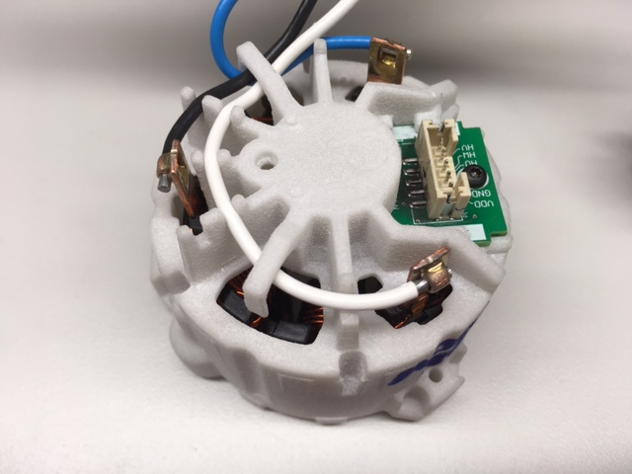
1 – Insert and solder motor wires
3
2
1
Insert W wire, then V wire, and last U wire into terminals and traps

Slide 9
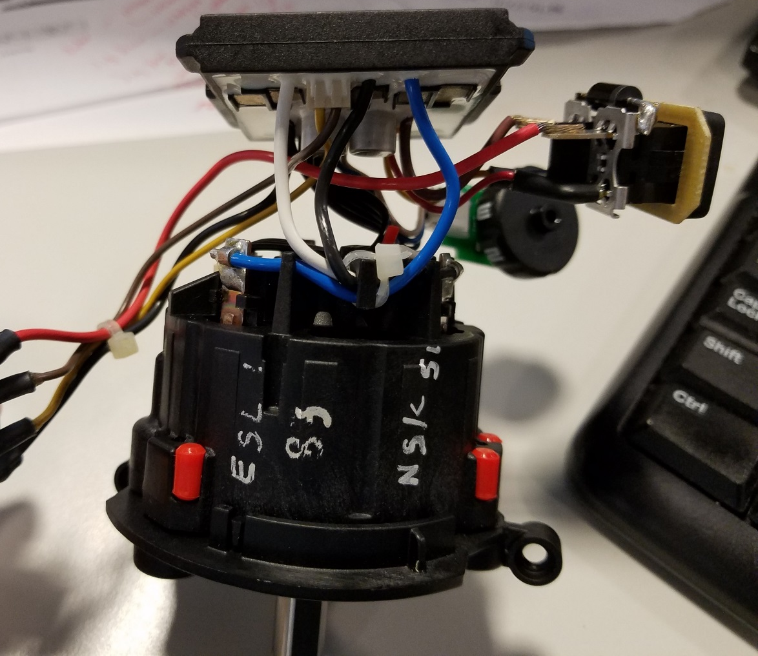
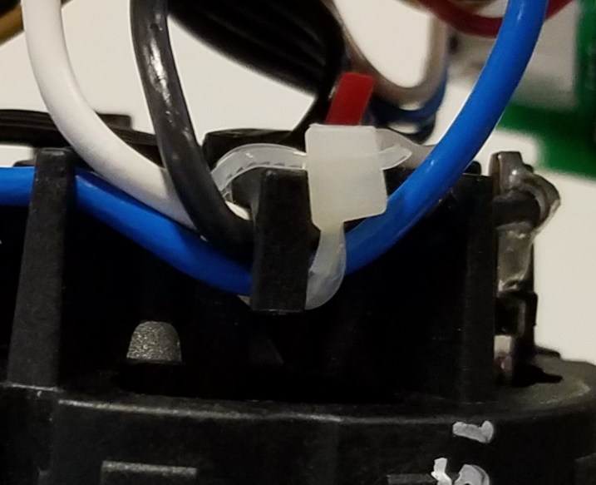
Zip tie assembly
Assemble zip tie wrapping U,V,W wires to plastic hook feature
Cut remain zip tie material
Make sure not to damage insulation wires at cutting process

Slide 10
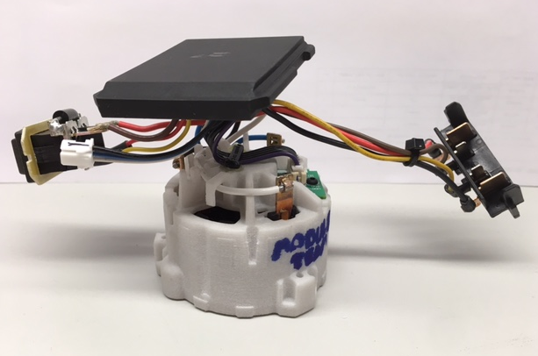
2 – Connect Hall wire harness
Connect harness & strain relief

Slide 11
3 – Assembled motor & module

Slide 12
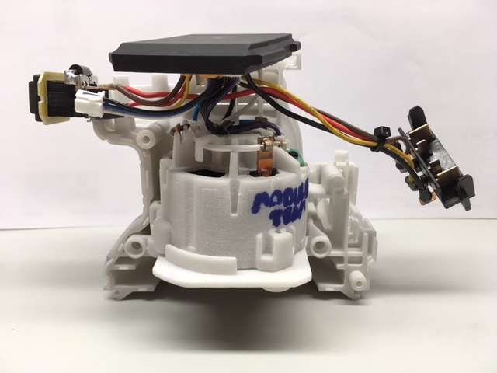
4 – Insert motor into housing

Slide 13
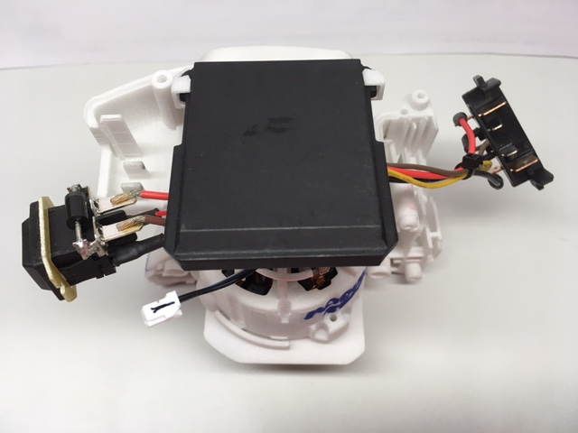
5 – Insert module into housing

Slide 14
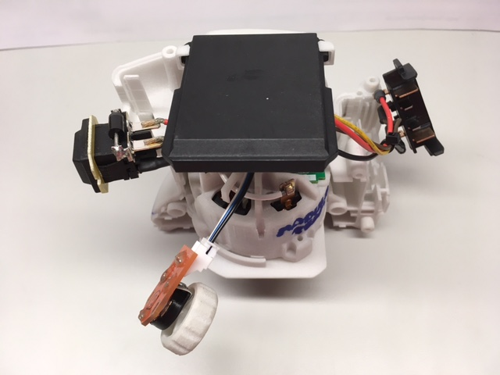
6 – Connect speed dial

Slide 15
7 – Attach cover housing
.

Slide 16
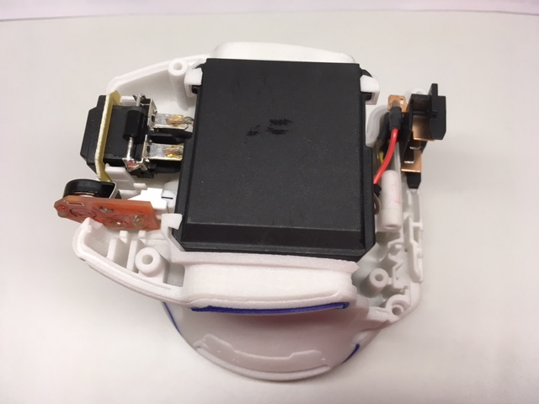
8 – Switch, speed dial, & terminals assembled into housings
Switch mounting panel
held by ribs on both sides
Terminal block
Speed dial
(wheel not shown)

Slide 17
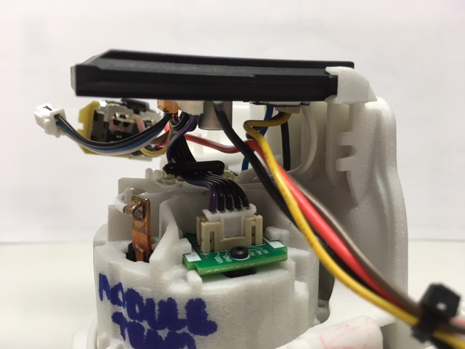
9 – Confirm internal wire routing
Confirm phase wires are BEHIND
terminal block & switch wires

Slide 18
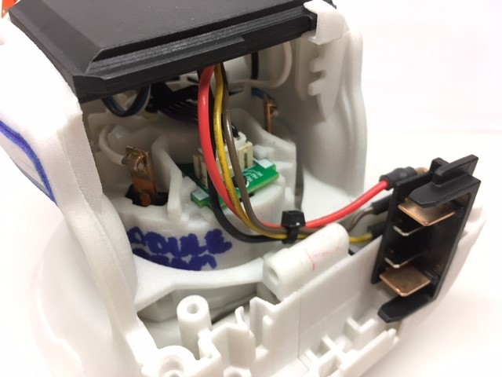
10 – Terminal block wires
Terminal block wires must be clear of housing edge – visually confirm before assembling top cap
Zip tie may help pull wires into housing

