Slide 1
Lock and pusher spring assembly
Dulce Hernández

Slide 2
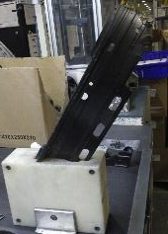
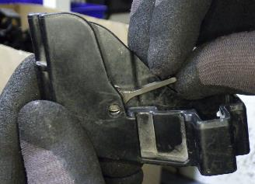
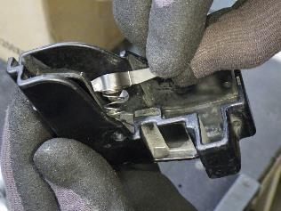
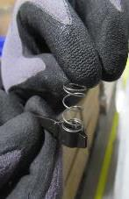
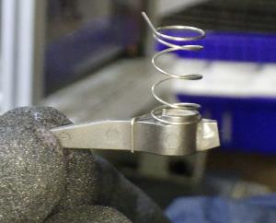
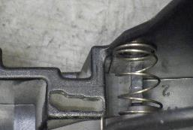
Lock and pusher spring assembly
1.- The magazine is placed on the fixture
3.- Insert the pusher lock SA into the magazine end cap, with the pusher lock on the bottom and the spring on the back aligned in the holes. The end of the spring should go into the slot in the magazine end cap.
2.- Take a pusher lock and spring and assemble as indicated.

Slide 3
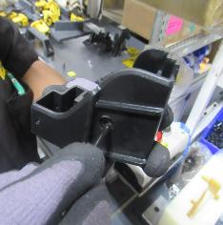
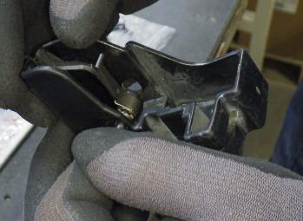
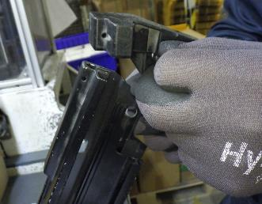
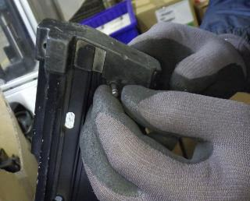
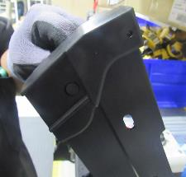
4.- Make sure the pin hole and the end cap hole are aligned, then insert a pusher lock pin with the thinner side into the bottom hole of the SA magazine end cap.
5.-Hold the tip of the pusher lock pin. Push the pusher lock extension forward and pull the pin out.
6.- Take the SA end cap and without releasing the pin, insert the SA into the tip of the magazine.
7.- Make sure the head of the pin has entered the hole in the magazine.

Slide 4
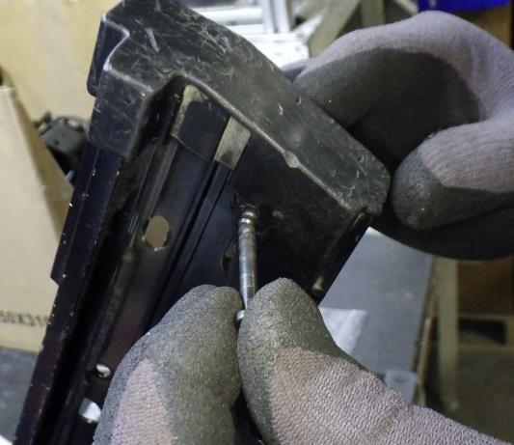
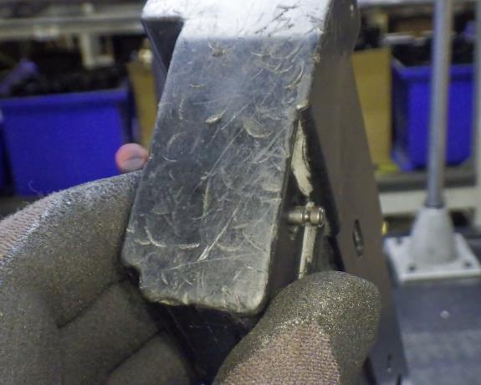
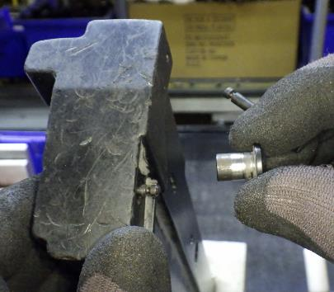
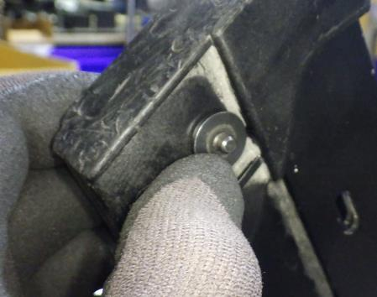
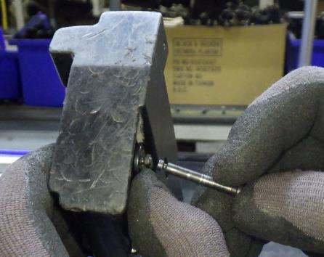
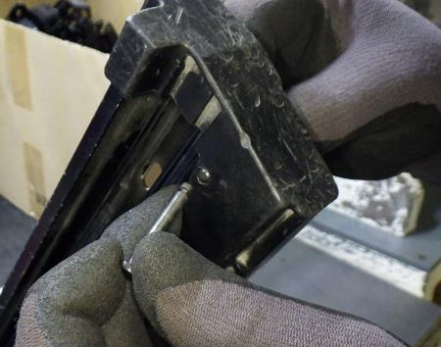
8.- Take another pusher lock pin and insert it by pushing the magazine pin until it is out and the inserted pin is in place.
9.- Take a lock shoulder and place it as shown in the image.
10.- take the previously used pusher lock pin and insert it into the hole in the magazine on the side of the pusher shoulder, replacing the other pin.

Slide 5
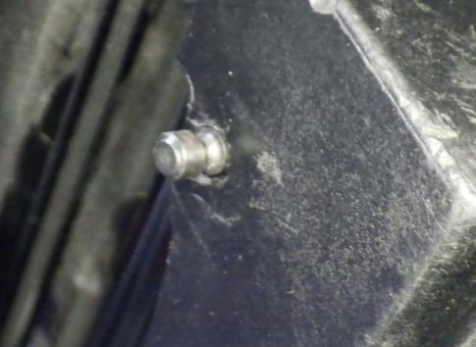
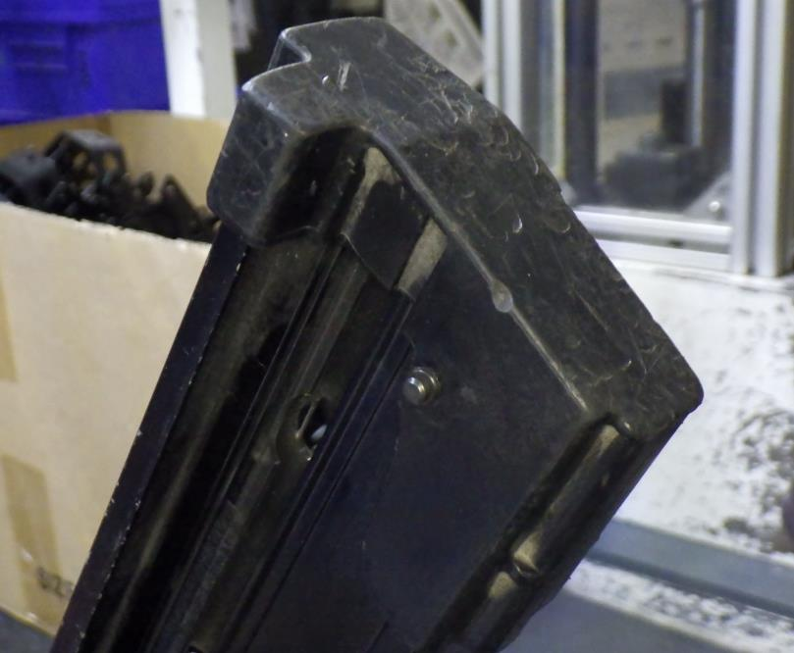
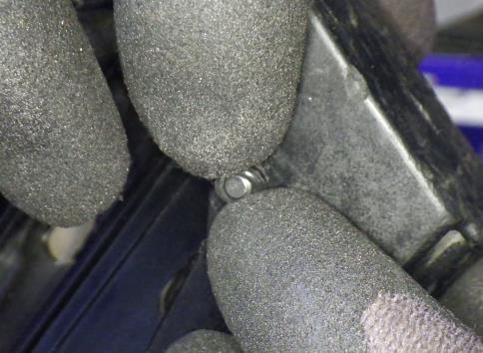
11.- Put a pusher lock grommet in the pin slot.

