Slide 1
O-Ring Damper Installation
VERSION: 0.5
CN NUMBER: CN0280330
03/23/2017
DOC#: DOC100314134
Applicable Tools:
18G DEWALT BRAD, 18G NCS, 18G EHF, 15G DEWALT DA
18G BOSTITCH BRAD, 16G BOSTITCH STRAIGHT, 15G BOSTITCH FN

Slide 2
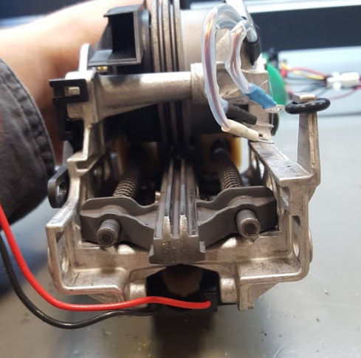
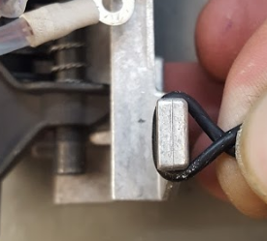
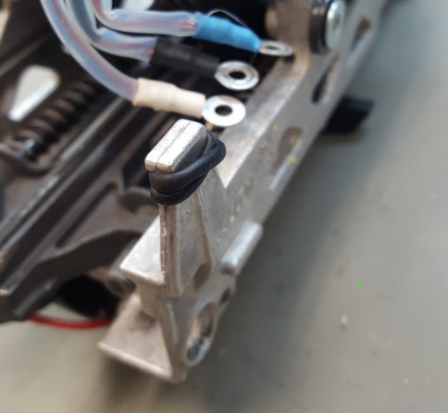
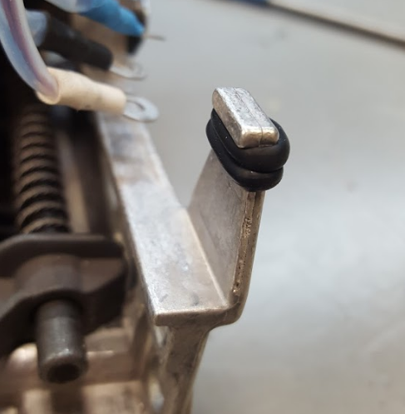
Twisted O-Ring Installation
Step 1: Install the O-Ring around top of the metal feature.
Step 2:
Twist the O-Ring
Step 3:
Wrap the O-Ring around the metal feature again.
GOOD

Slide 3
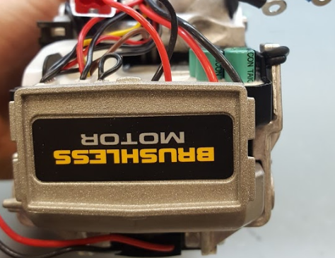
Twisted O-Ring Installation
After completing the installation make sure that the O-Ring is between the Module and the metal frame.

